Slide 1
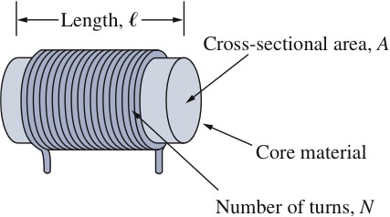
Inductors
An inductor is made of a coil of conducting wire

Slide 2
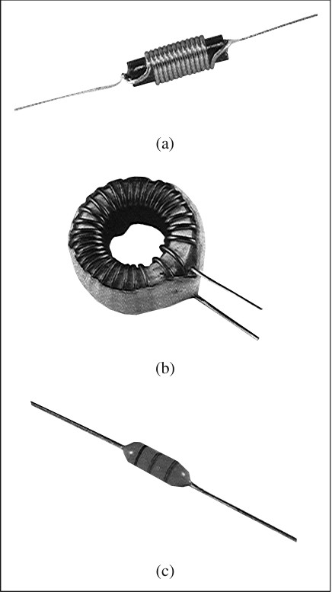

Slide 3
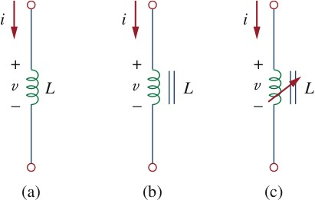
Symbol
air-core
(b) iron-core
(c) variable iron-core

Slide 4
Flux in Inductors
The relation between the flux in inductor and the current through the inductor is given below.
ψ
Linear
Nonlinear
i

Slide 5
Energy Storage Form
An inductor is a passive element designed to store energy in the magnetic field while a capacitor stores energy in the electric field.

Slide 6
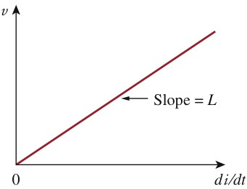
I-V Relation of Inductors
An inductor consists of a coil of conducting wire.
i
+
v
L
-

Slide 7
Physical Meaning
When the current through an inductor is a constant, then the voltage across the inductor is zero, same as a short circuit.
No abrupt change of the current through an inductor is possible except an infinite voltage across the inductor is applied.
The inductor can be used to generate a high voltage, for example, used as an igniting element.

Slide 8
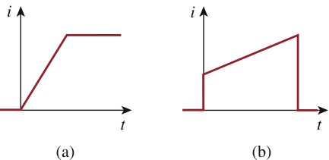
Fig 6.25
An inductor are like a short circuit to dc.
The current through an inductor cannot change instantaneously.

Slide 9
+
v
L
-

Slide 10
Energy Stored in an Inductor
The energy stored in an inductor
+
v
L
-

Slide 11
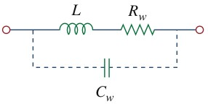
Model of a Practical Inductor

Slide 12
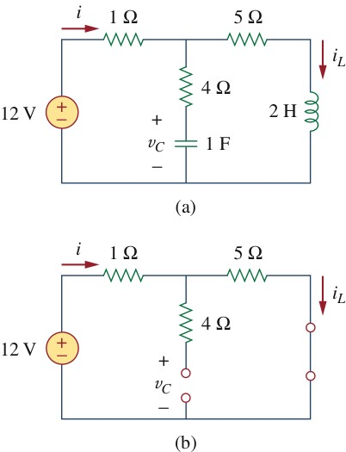
Example 6.10
Consider the circuit in Fig 6.27(a). Under dc conditions, find:
(a) i, v_{C}, and i_{L}.
(b) the energy stored in the capacitor and inductor.

Slide 13
Example 6.10
Solution:

Slide 14
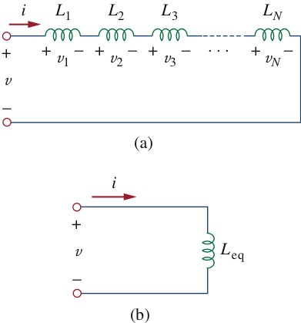
Inductors in Series

Slide 15
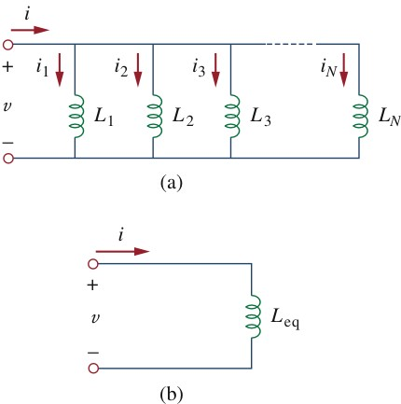
Inductors in Parallel

Slide 16
6.5 Series and Parallel Inductors
Applying KVL to the loop,
Substituting v_{k} = L_{k} di/dt results in

Slide 17
Parallel Inductors
Using KCL,
But

Slide 18
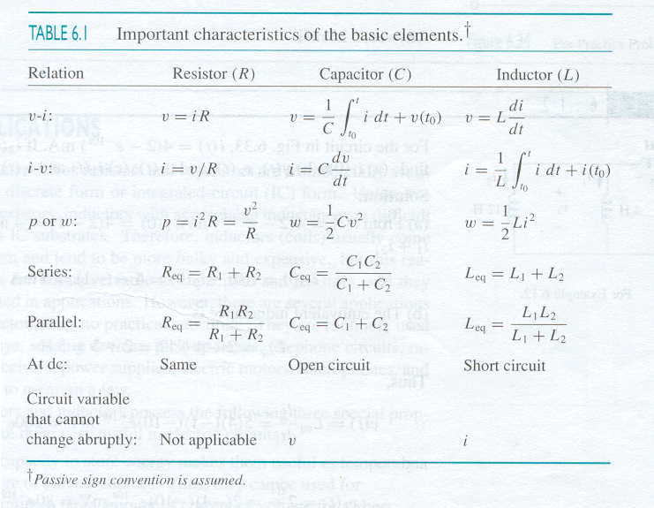
Table 6.1

Slide 19
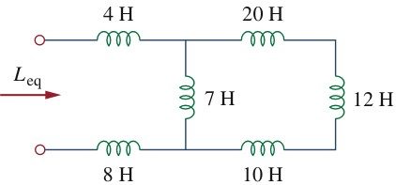
Example 6.11
Find the equivalent inductance of the circuit shown in Fig. 6.31.

Slide 20
Example 6.11
Solution:

Slide 21
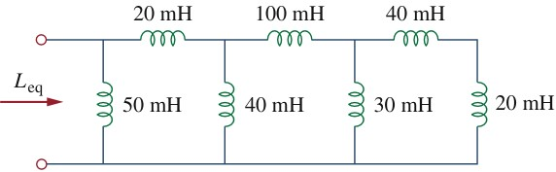
Practice Problem 6.11

